Slide 1
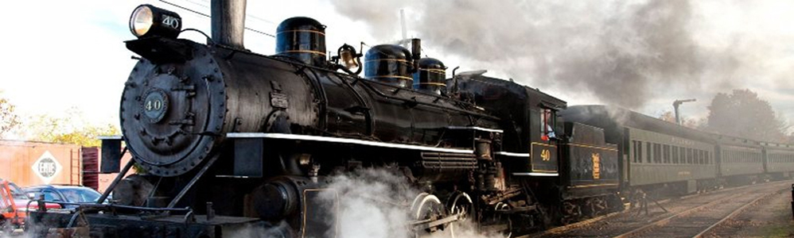
Online railway reservationsystem
Presented by:
Manvith J
Suma J
Chaitra Vishnu Devanga

Slide 2
Problem statement
Information about the route,cancellation of tickets,departure time,arrival time number of trains available and other such information
Keep track of all its passengers and thus schedule their journey accordingly
Maintains records of passengers travelling in the trains on different dates reaching different destination in the system
User friendly interface to administrators and users

Slide 3
Who are all the users?
Administrator
Passenger
Travel agent
Financial gateway
Reservation clerk

Slide 4
Reservation
Acquire passenger details
Check for availability
Issues tickets

Slide 5
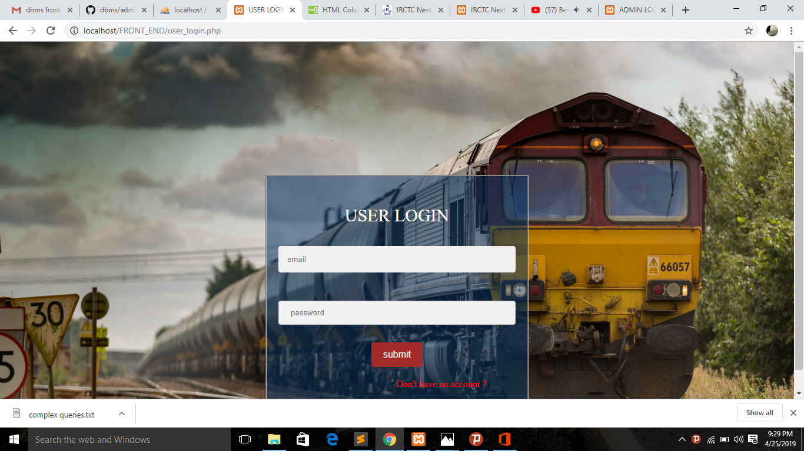
Home page

Slide 6
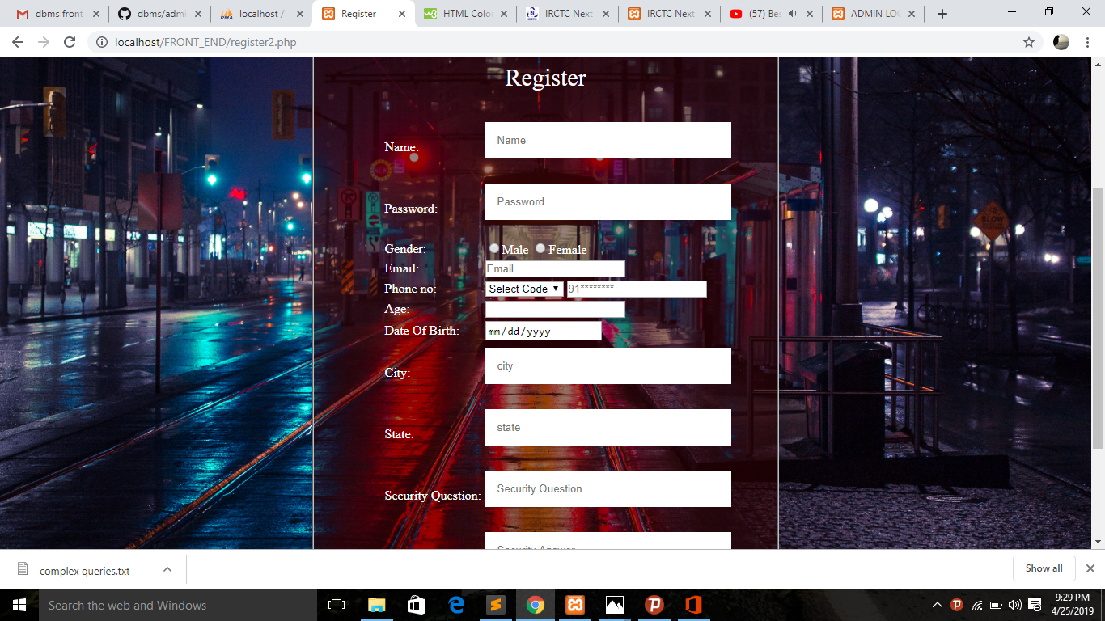
Registration page

Slide 7
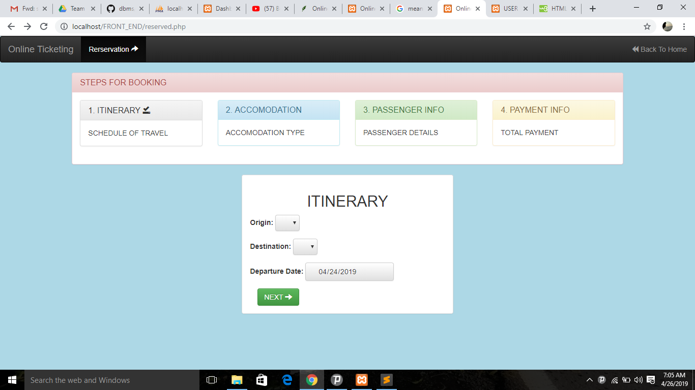
Booking details

Slide 8
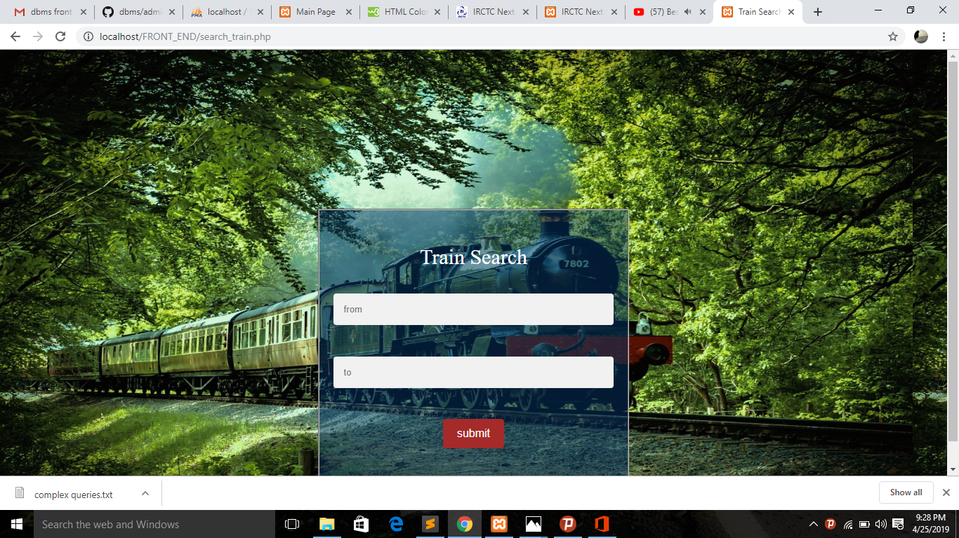
Contd

Slide 9
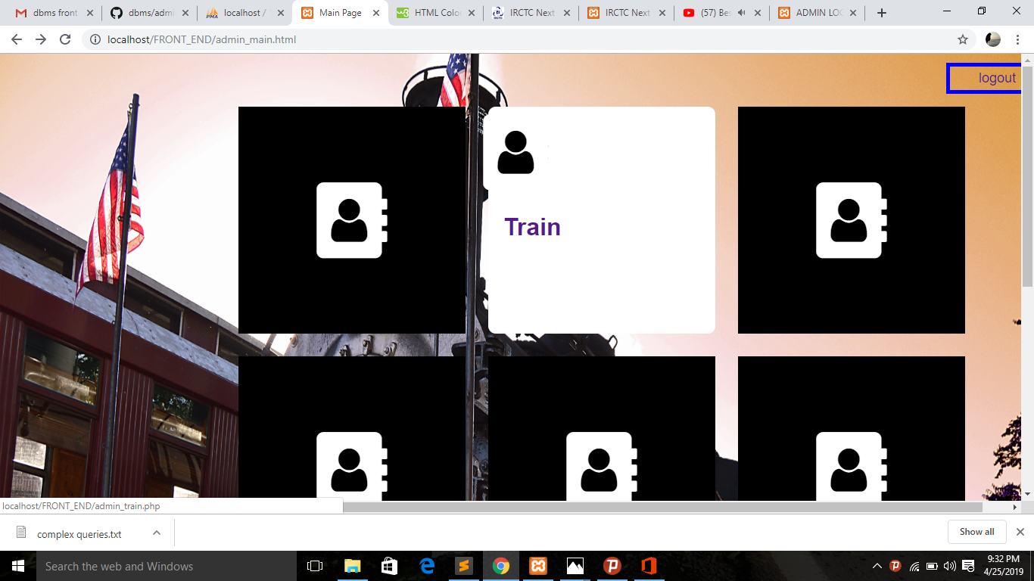
Contd

Slide 10
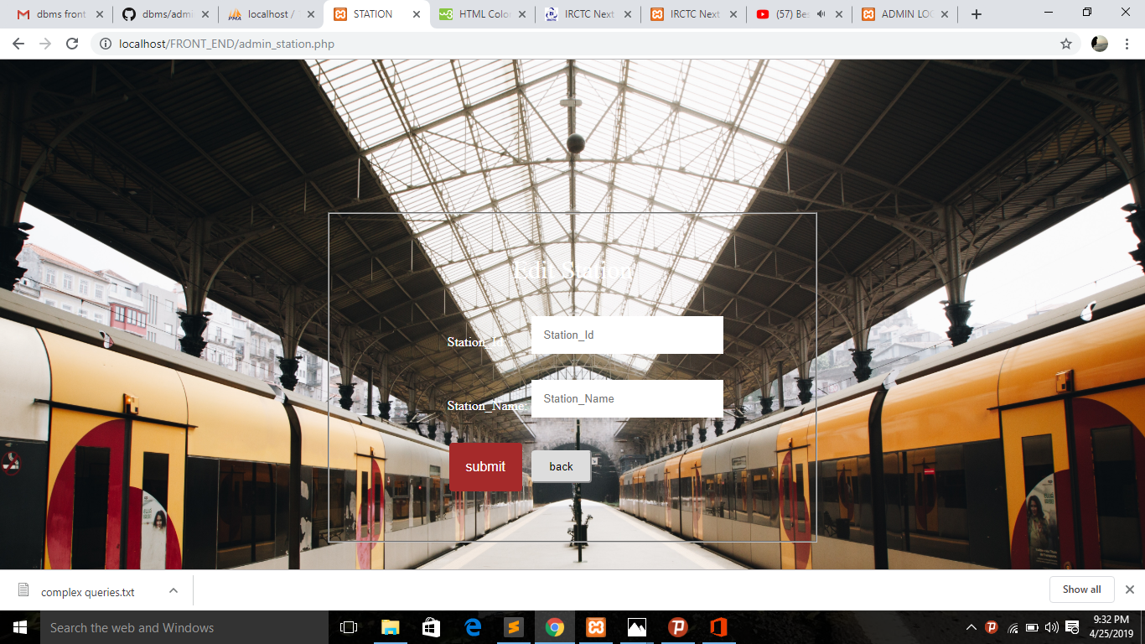
Contd

Slide 11
Features
Searching trains is easier
Passengers wont have to wait for a long time
Information is accurate
It is a fast process
Data efficiency is more

